Slide 1
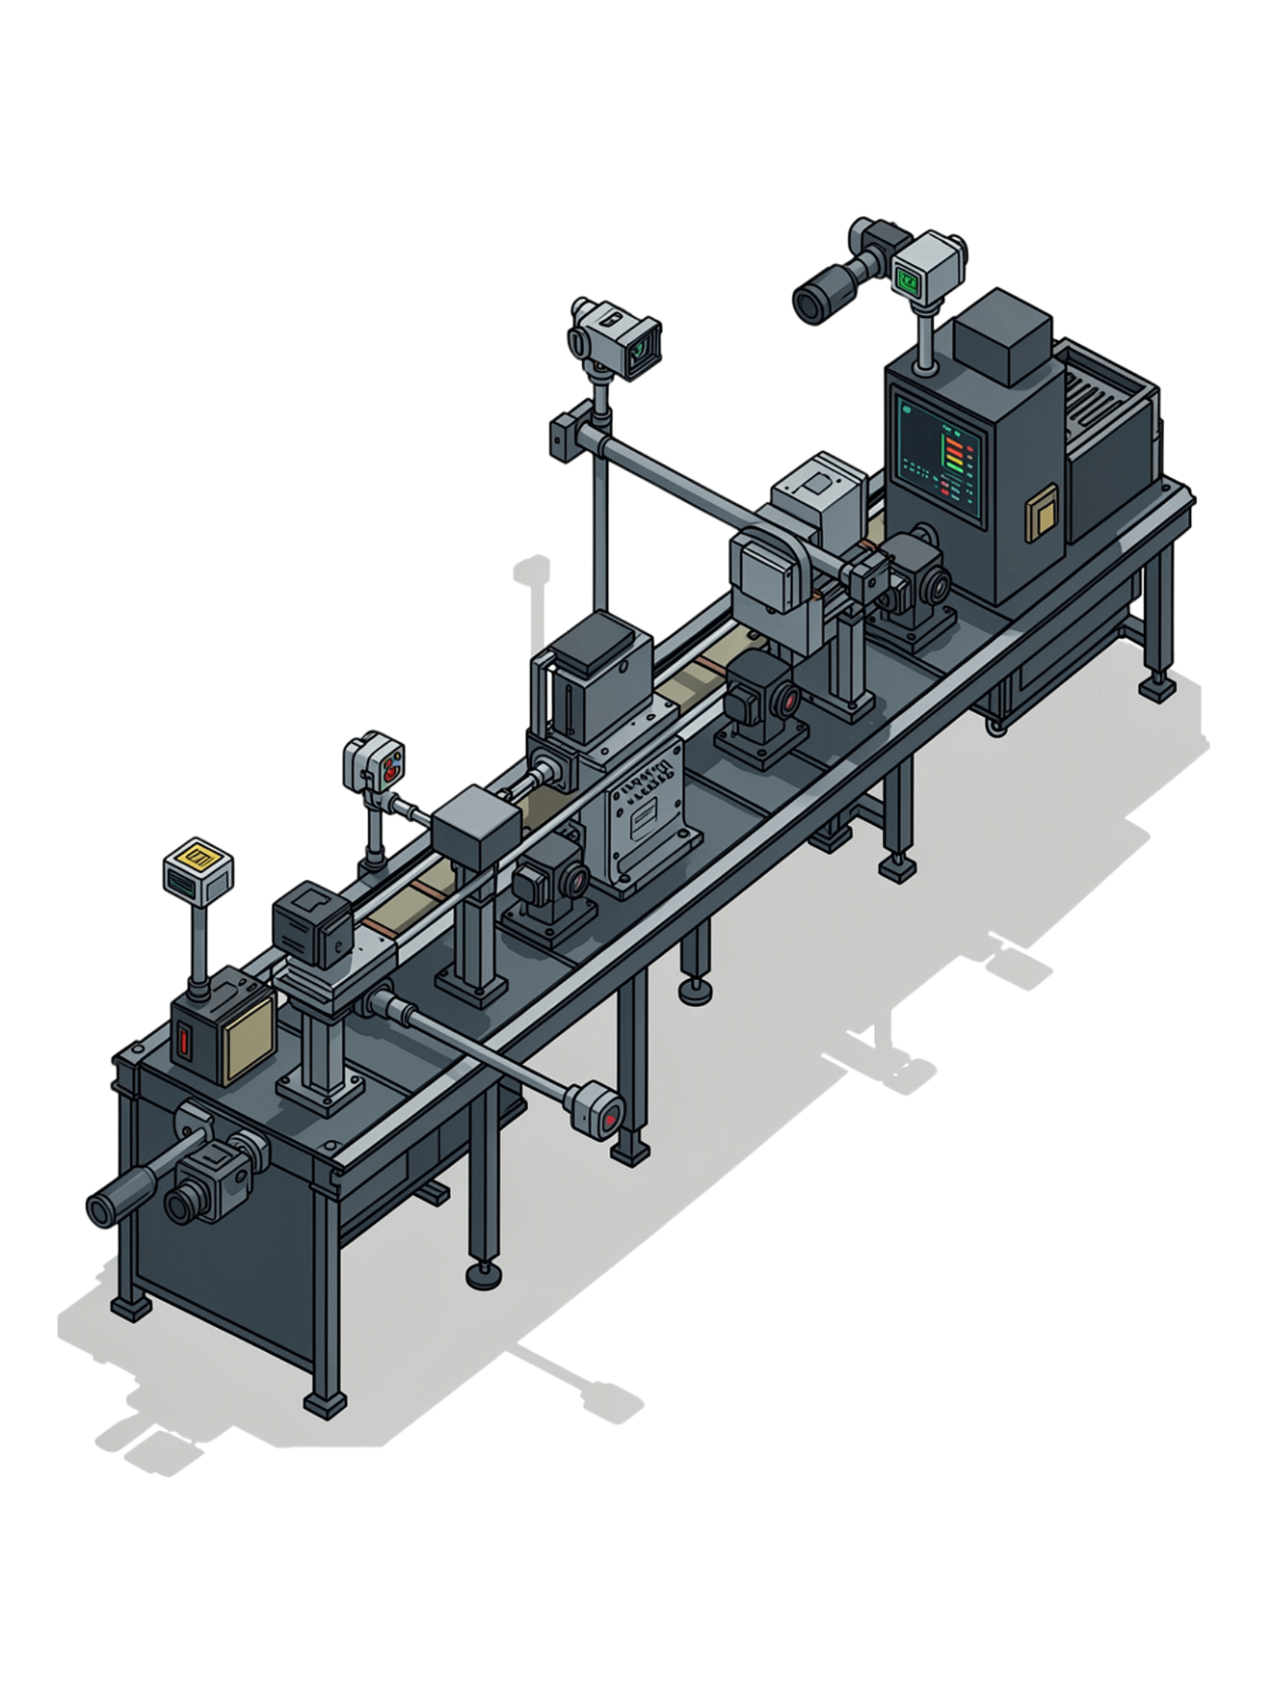
Manufacturing Quality Intelligence System (MQIS)
Software Engineering (UCS503)
Bharat (1024240013)
Asmita (1024240014)
Rishit (1024240030)

Slide 2


The Problem: Manual QC Doesn't Scale
Slow & Inconsistent
Human inspectors check each part visually — unable to keep pace across parallel production lines.
Detection Without Diagnosis
Existing automated systems flag defects but cannot explain why they are happening.
No Real-Time Visibility
Supervisors review data end-of-shift, missing live failures as they compound on the floor.

Slide 3
Four Concrete Challenges
Detection ≠ Diagnosis
No Real-Time Visibility
A defect is flagged, but there is no connection to its root cause or emerging pattern.
A failing machine can produce dozens of rejects before anyone on the floor notices.
Knowledge is isolated
Manual Reporting
Technician expertise lives in heads and paper logs — never captured inside the system.
Shift reports are time-consuming and pull skilled technicians away from the production floor.

Slide 4

Our Four-Layer Solution
1
Vision-based Detection
Image differencing and contour analysis classifies defects — bent, color, scratch — with severity and confidence score.
2
Event Logging
Vision Detection
Every inspection is logged with timestamp, line ID, defect type, and severity for full traceability.
Event Logging
Live Analytics
3
Live Analytics
RAG Explanation
Real-time per-line rejection rates, status flags (Normal / Warning / Critical), and hourly defect breakdowns.
4
RAG-based Explanation
LLM retrieves curated factory knowledge, combines it with live data, and generates grounded shift reports and root-cause insights.

Slide 5
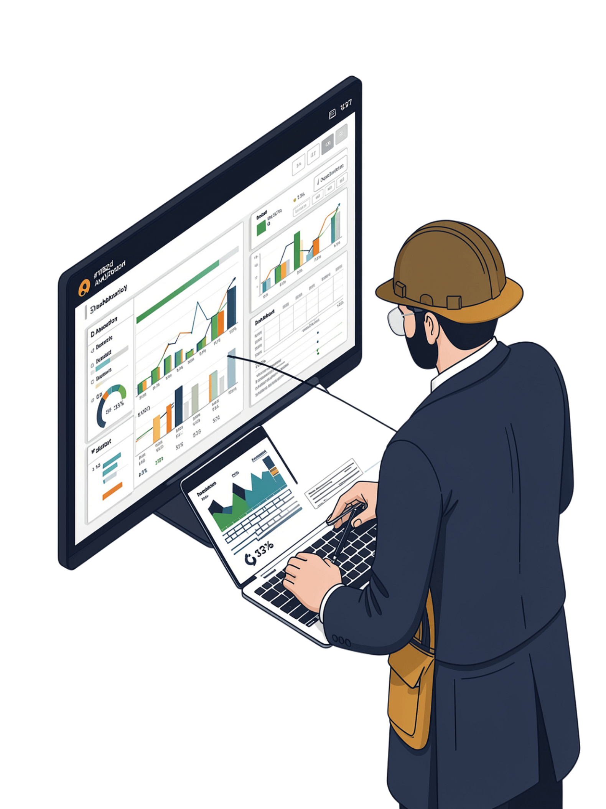




The Innovation: From Detection to Understanding
Detect
Vision system flags defects instantly, in real time, on every production line.
Understand
RAG grounds LLM outputs in real data and curated factory knowledge — no hallucinations.
Act
Supervisors receive explainable answers in plain English, not black-box flags or raw logs.
Future roadmap: extend SentinelLine to predictive maintenance by leveraging early trend detection from accumulated event logs.

